Slide 1

Fraud Detection in Bank Transactions
Darwhin Gomez
Data 602
Fall 2024
Notes:
Fraud detection remains a critical challenge in the financial industry. As fraudulent activities can involve abnormal transaction behaviors, detecting outliers or anomalies in large transaction datasets is key to identifying potential fraud. This project uses unsupervised learning techniques such as anomaly detection to flag suspicious transactions based on transaction data.

Slide 2
Can anomalies in bank transactions be detected using unsupervised machine learning specifically Isolation Forrest, and what features contribute the most to identifying these anomalies?
Notes:
The objective of this project is to detect anomalies in bank transactions using the Isolation Forest algorithm. Bank transactions can exhibit suspicious patterns indicative of fraud, such as high transaction amounts, repeated login attempts, and unusual transaction times. This analysis uses a dataset containing transaction details, customer information, and contextual data. The goal is to identify outliers and understand the key factors influencing the model’s anomaly detection.

Slide 3
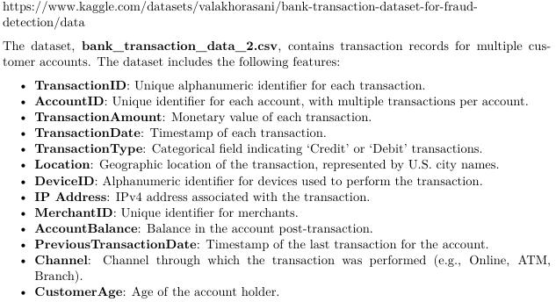
The Data

Slide 4
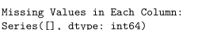
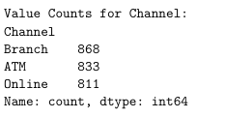
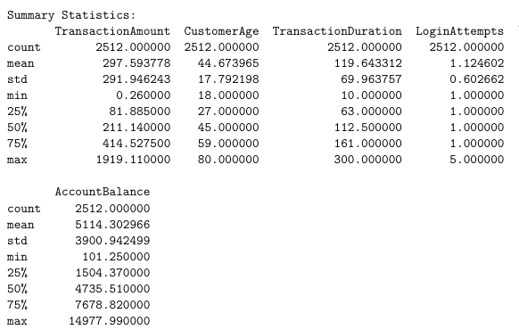
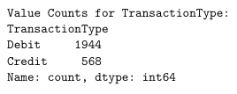
Exploring The Data

Slide 5
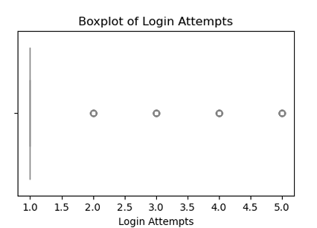
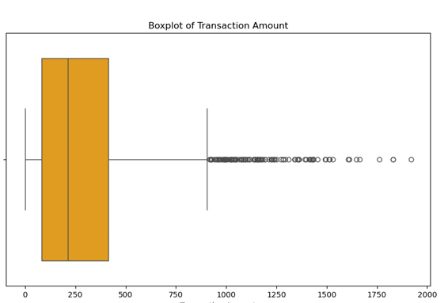
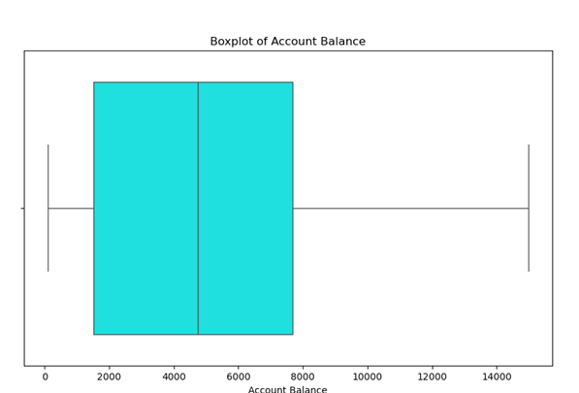
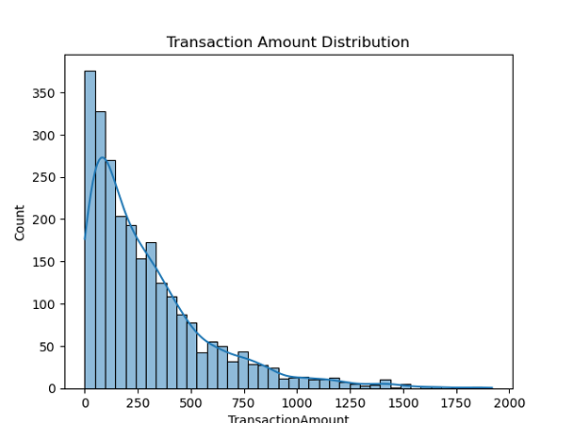
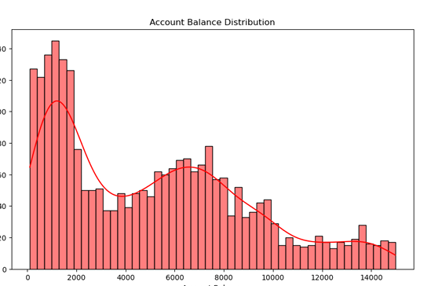
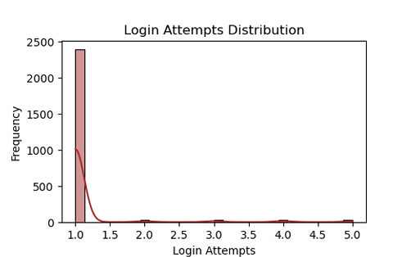

Slide 6
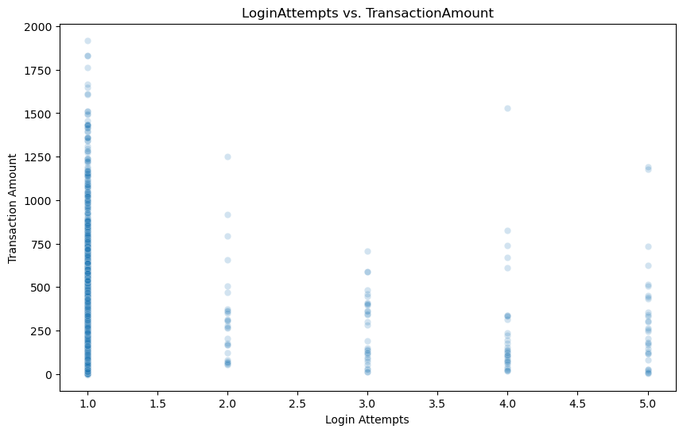
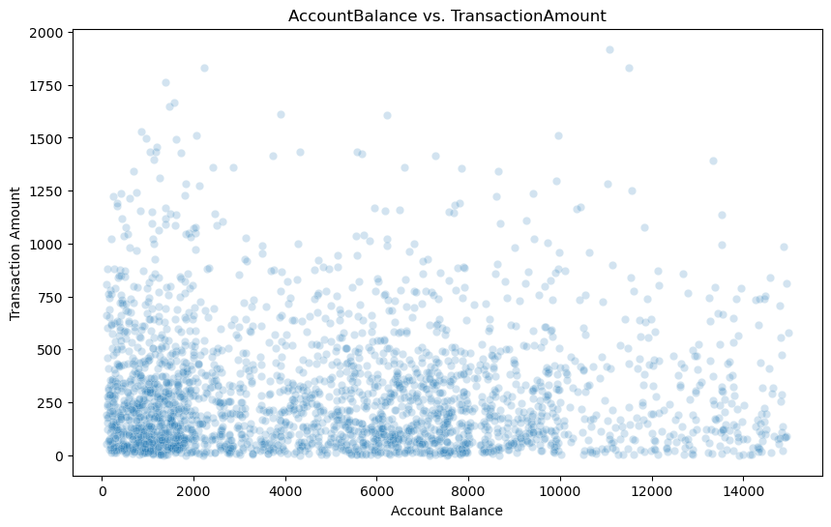
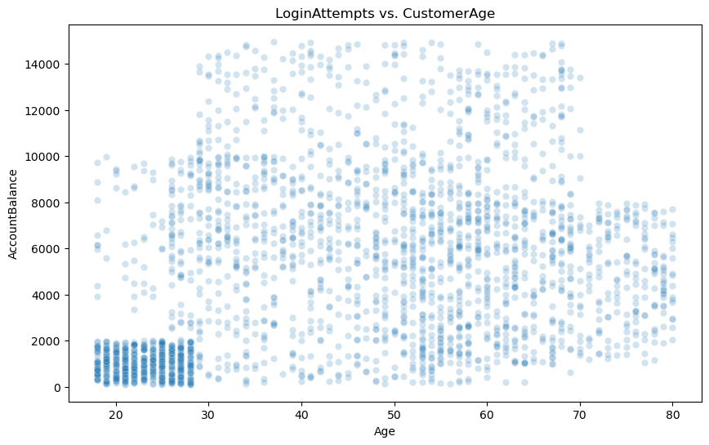

Slide 7
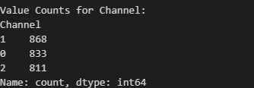
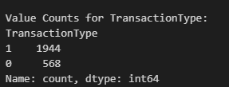
Data Processing
categorical_columns = ['TransactionType', 'Location', 'Channel', ]
le = LabelEncoder()
for col in categorical_columns:
df[col] = le.fit_transform(df[col])
df[categorical_columns].head(10)
for col in categorical_columns:
print(f"\nValue Counts for {col}:")
print(df[col].value_counts())

Slide 8
# Covert date cols to datetime
df['TransactionDate'] = pd.to_datetime(df['TransactionDate'])
df['PreviousTransactionDate'] = pd.to_datetime(df['PreviousTransactionDate'])
# Extract thr datetime features
df['TransactionHour'] = df['TransactionDate'].dt.hour
df['TransactionDay'] = df['TransactionDate'].dt.day
df['TimeDiffSeconds'] = (df['TransactionDate'] - df['PreviousTransactionDate']).dt.total_seconds().abs()
# Standardize the numerical Data
scaler = StandardScaler()
numerical_columns = ['TransactionAmount', 'AccountBalance', 'TransactionDuration', 'LoginAttempts', 'TransactionHour', 'TransactionDay', 'TimeDiffSeconds']
df[numerical_columns] = scaler.fit_transform(df[numerical_columns])

Slide 9
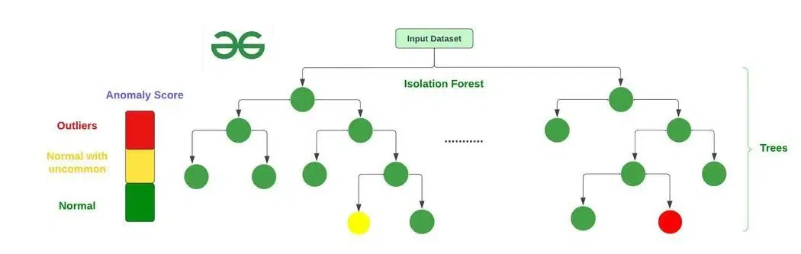
Model:
Isolation Forrest
https://www.geeksforgeeks.org/what-is-isolation-forest/#how-isolation-forest-algorithm-works
Notes:
The Isolation Forest is an unsupervised machine learning algorithm used for anomaly detection. It works by isolating data points through recursive random splits. Anomalies (outliers) are easier to isolate because they are:
Farther from other points or
In low-density regions of the dataset.
Key Idea: Anomalies are isolated with fewer splits compared to normal points.
How It Works:
Randomly select a feature and a split value.
Partition the data until individual points are isolated.
The number of splits (or depth of the tree) needed to isolate a point is measured.
Anomalies are isolated with shorter paths (fewer splits).

Slide 10
# Train Isolation Forest
features = ['TransactionAmount', 'AccountBalance', 'TransactionDuration',
'LoginAttempts', 'TransactionHour', 'TransactionDay', 'TimeDiffSeconds',
"Location", "TransactionType","CustomerAge","Channel"]
iso_forest = IsolationForest(n_estimators=100, contamination=0.01, random_state=42)
df['anomaly'] = iso_forest.fit_predict(df[features])
==============
Number of anomolies detected : 26 TransactionType
0 16 (Credit)
1 10 (Debit)

Slide 11
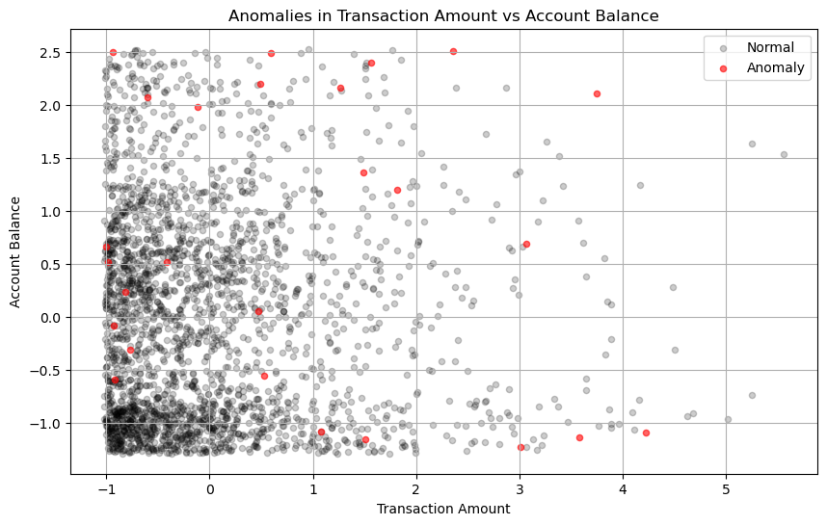

Slide 12
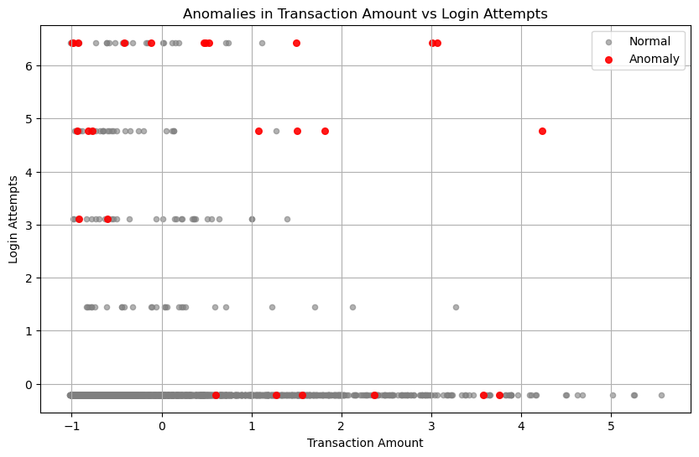

Slide 13
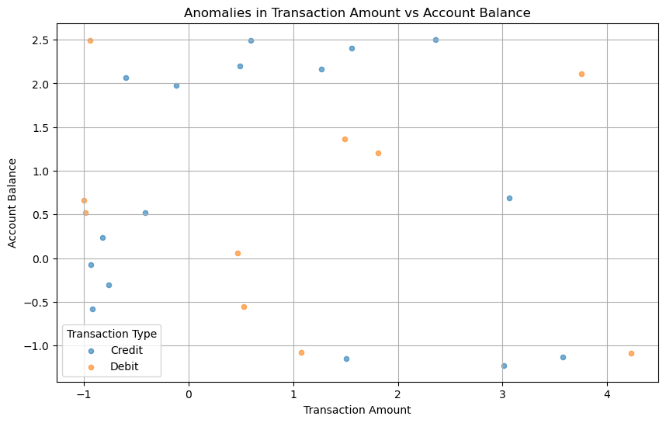

Slide 14
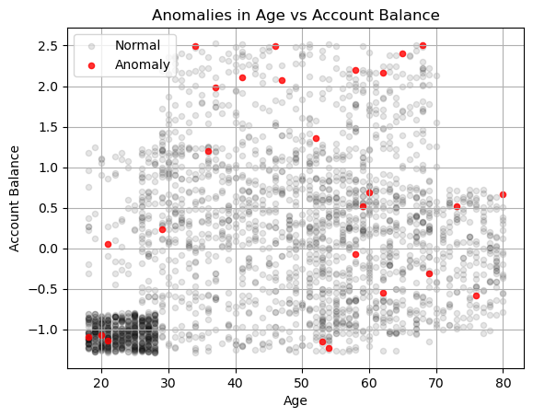

Slide 15
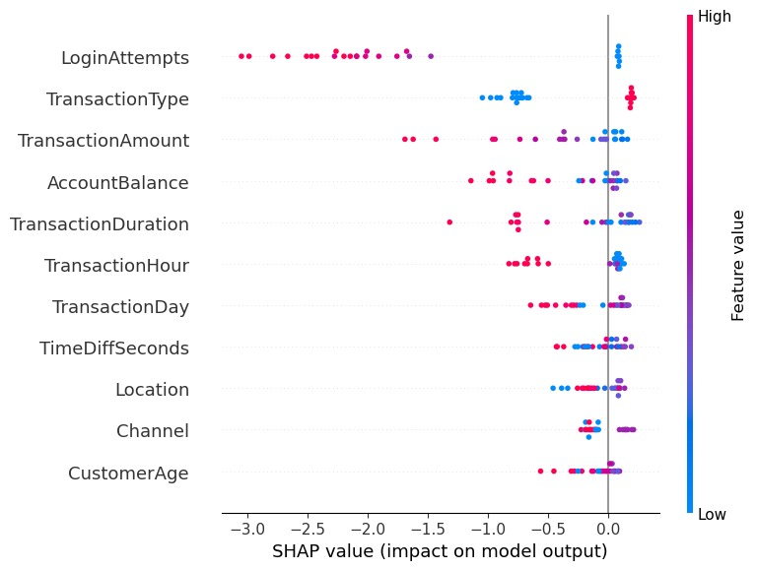
Analyzing The Model
SHAP
(SHapley Additive exPlanations)
import shap
# Create SHAP explainer
explainer = shap.Explainer(iso_forest)
# Calculate SHAP values for the sample data
shap_values = explainer(anomalies[features])
# Visualize SHAP values for the sample data
shap.summary_plot(shap_values, anomalies[features])
Notes:
Interpretability: SHAP provides insight into how individual features affect predictions.
Global and Local Explanations: SHAP can explain the overall model behavior (global) and individual predictions (local).
Additivity: The sum of SHAP values for a prediction equals the difference between the model's output and the expected output.

Slide 16
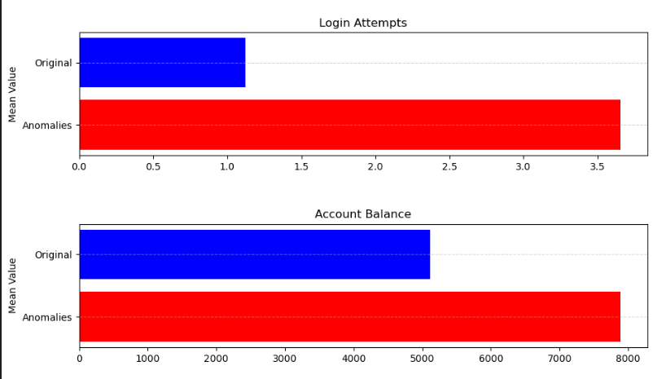
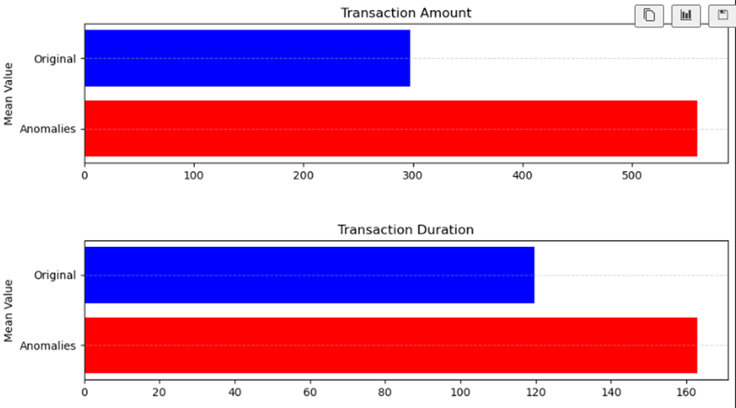
Metric | Percent Change in Mean
Transaction Amount | 87.914244
Transaction Duration | 36.145102
Login Attempts | 225.000000
Account Balance | 54.205561
Transaction Hour | 1.551786
Transaction Day | 22.720667
Time Difference in Seconds | -0.936070
Notes:
Percent Change Analysis
Transaction Amount:
Anomalies have a significantly higher transaction amount (+87.91%). This suggests that unusually large transactions are more likely to be flagged as anomalies.
Login Attempts:
Anomalies show a 225% increase in login attempts. This is a strong indicator of potential fraud (e.g., repeated attempts to access accounts).
Transaction Duration:
Anomalies take longer to process (+36.15%), which could indicate more complex or suspicious transactions.
Account Balance:
Anomalies are associated with higher account balances (+54.21%). This could suggest high-value accounts being targeted.
Transaction Hour and Day:
Although the differences are smaller, anomalies tend to happen at slightly different hours and on different days compared to normal transactions.
Time Difference in Seconds:
The time between transactions for anomalies is slightly shorter (-0.94%), which indicates this feature is not a stong indicator of afor anomaly detection.

Slide 17
Conclusions
Exploring, Reasearch Processing
Isolation Forest Results
Top Features Driving Anomalies
Anomaly vs. Normal Transaction Comparison
Transaction Type Analysis
Future Enhancements
Key Takeaways
Notes:
Conclusion
The goal of this project was to find unusual transactions (anomalies) in bank data using the Isolation Forest algorithm and figure out which features made these transactions stand out. Since the data didn’t have labels, we used unsupervised learning methods and tools to understand the results.
Data Preparation:
We encoded categories like TransactionType, Location, and Channel.
We standardized numerical features like TransactionAmount, AccountBalance, and LoginAttempts.
We created time-based features, such as TransactionHour and TransactionDay.
Anomaly Detection:
We ran the Isolation Forest with a contamination rate of 0.01, based on the idea that less than 1% of transactions are typically fraud.
The model flagged 26 transactions as anomalies.
Understanding the Model:
We used SHAP (SHapley Additive exPlanations) to see which features the model relied on most.
The key features that led to anomalies were:
Transaction Amount
Login Attempts
Account Balance
Transaction Type
Comparing Means:
We compared the average values of numerical features between anomalies and normal transactions. This showed that anomalies often had higher transaction amounts, more login attempts, and higher account balances.
We also compared the value_counts od tranaction types, while 0ver 70% all tranctions were debit transactions only 38% pf the anomalies where debit type indicating the suspcisous activity might me more prevalent on credit tranactions.
Answering the Research Question:
We wanted to know how to detect anomalies in bank transactions with no labels and what features are most important. The Isolation Forest helped us find these anomalies, and SHAP showed us which features mattered most. By combining the model's results with our understanding of the data, we got a clearer picture of what makes these transactions unusual.
Future Studies
To improve anomaly detection in future studies, adding features like Device ID and IP address could be valuable. For example:
ATM Locations: ATMs are known hotspots for suspicious transactions. Including Device IDs for ATMs can help flag anomalies more accurately.
IP Address Tracking: If an account shows multiple login attempts from an unfamiliar IP address, this could indicate potential fraud or unauthorized access.
These additional features can enhance the model’s ability to detect anomalies and provide more context for understanding suspicious activities.
This project shows that unsupervised learning can do a good job of finding outliers, even when we don’t have labeled data. Using tools like SHAP helps explain the model's decisions, and adding domain knowledge makes the results meaningful.

Slide 18
References
GeeksforGeeks:
Isolation Forest Algorithm for Anomaly Detection
https://www.geeksforgeeks.org/ml-isolation-forest-algorithm/
Think Python:
Think Python: How to Think Like a Computer Scientist by Allen B. Downey
https://greenteapress.com/wp/think-python-2e/
Kaggle Dataset:
Credit Card Fraud Detection Dataset
https://www.kaggle.com/datasets/valakhorasani/bank-transaction-dataset-for-fraud-detection

Slide 19
Connect
Collaborate
Succeed
Github
Linkedin

